Slide 1
Racketeer
Prototyping Controlled Ransomware Operations
DEFCON 29
@Op_Nomad

Slide 2

$ who –m
Dimitry Snezhkov
Attack & Pen Team
Tools, research, automation

Slide 3
Ransomware: A Problem of Winning Business Model
330% YoY growth in 2020 – high
Return on capital speed vs. other cyber channels – high
Cost of customer acquisition per unit of attack – low
Stealth mode to holding period to monetization – hours+
Paying customer base, funding and feature iteration – days
Barrier of entry – low
Monetization activation path – fast
Attribution vs. Investment (technical and operational) – moderate
Ransomware is an efficient economic exit activity.

Slide 4
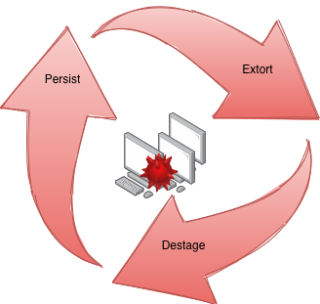
Ransomware: Disrupting the Lifecycle
Preventive and Detection Controls
Disaster Recover Drills
Incident Response Triage
External Negotiation
Realistic Victim Goal: Increase Mean Time Between Failures
Achieved by:
Knowing Your Assets and Data
Checking Process via Simulation and Feedback

Slide 5
Racketeer Strategic Goals: Better Simulation and Feedback
Objective: Help with the Steps to Create / Refine Process
Pick your color:
Tabletop and IR kickoff (Purple)
Optics and IOCs (Blue)
Reference implementation for last mile objectives in campaigns (Red)
SLAs and verified asset recovery, online and offline (Org)
Protection of data access and authentication (Org)
Precise targets - leave customer mostly intact, testing is goal (Org)
Stealth is a balance (Red / Blue maturity dial)

Slide 6
Racketeer: Attack Lifecycle Alignment
Ransomware Simulation to address technical specifics:
Correct asset lock/unlock (encryption, decryption)
Reliable Life-Time Key Management
Realtime vs. offsite asset unlock capabilities
Dormancy and Activation
Flexibility (comms, targets, connectivity)
Let’s Build it
Notes:
Let’s define an operator

Slide 7
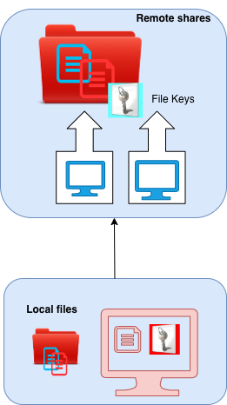
Construction: Tactical Features
Assets / Targets
Windows (agent)
Local files
Ability to remote on Internal Net
Tight Control of execution

Slide 8
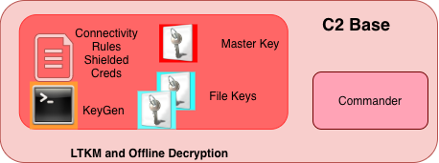
Construction: Tactical Features
KeyGen (offline)
LTKM
Encrypt/decrypt mode
Policies / Profiles
Offline asset recovery
Commander

Slide 9
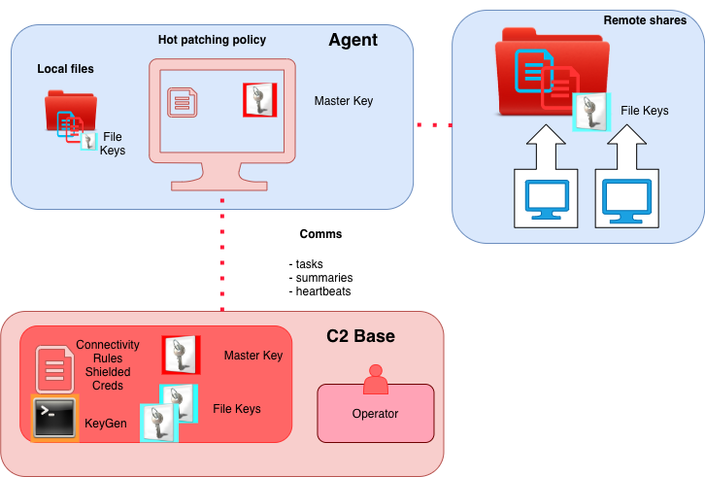
Construction: Tactical Features
Communication emulation
Transmission Layer encrypt
Appl-level message encrypt
REST endpoints

Slide 10
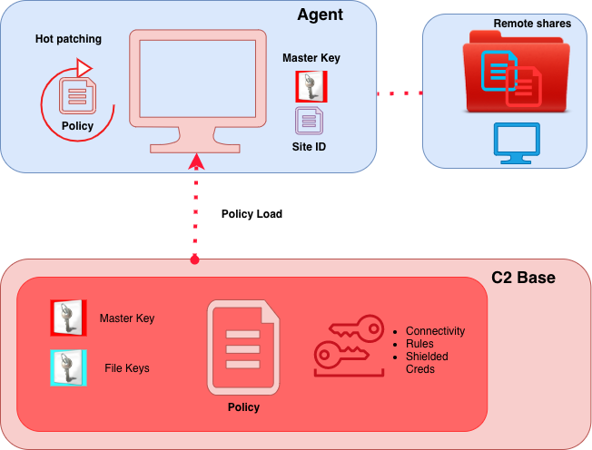
Construction: Tactical Features
Policy Hot Patching (real-time, remote)
Credential Shielding
Asset Connectivity Authentication Maps

Slide 11
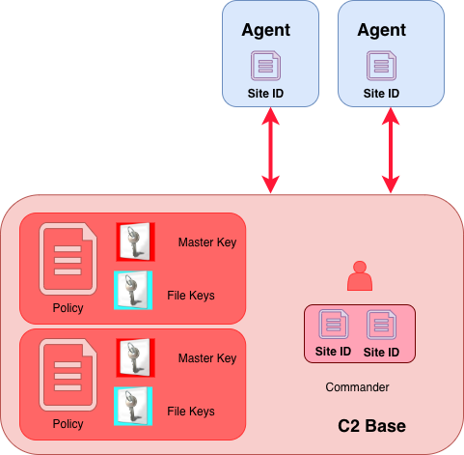
Construction: Tactical Features
Flexible Operations
Mutual Authentication of Base and Agents (Sites)
Delivery options and Trigger Control
Config File
Embedded Rsrc
Trigger on-launch or Dormant
Memory Log Ring Buffer
Destaging /Cleanup

Slide 12
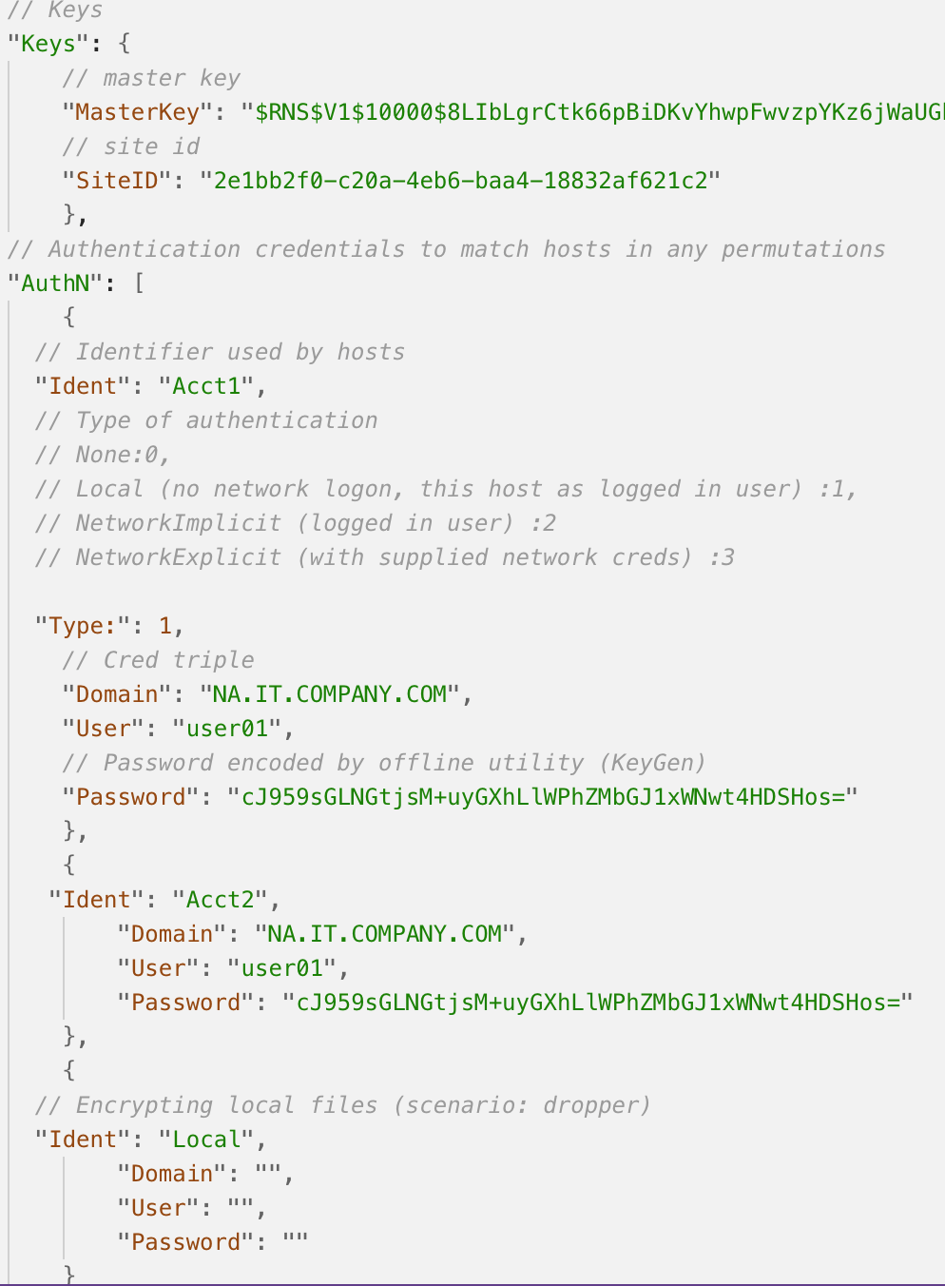
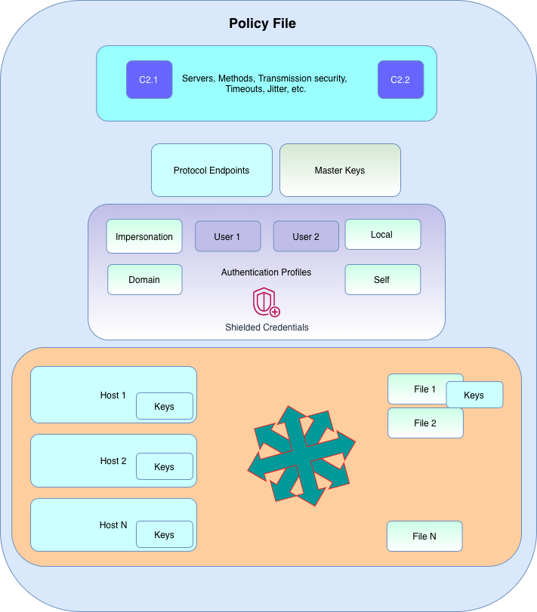
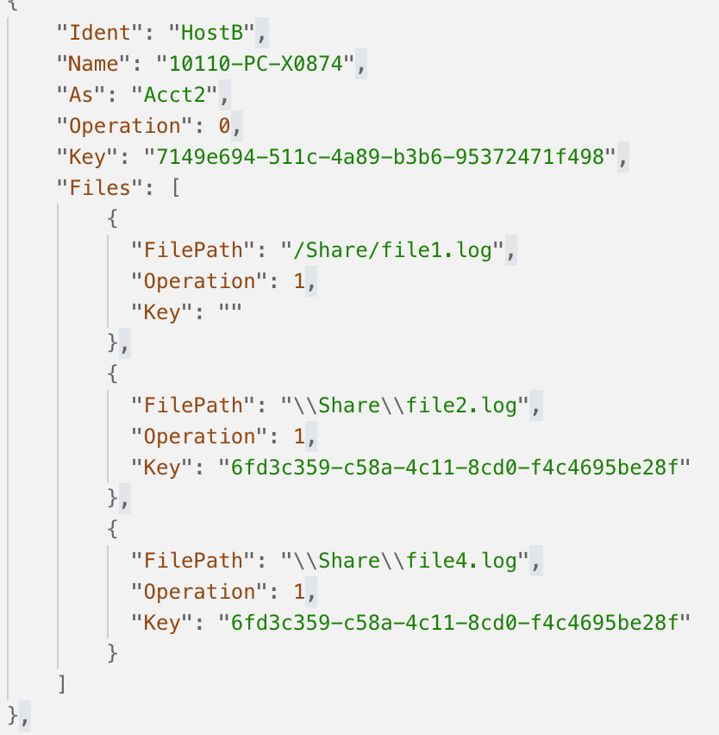
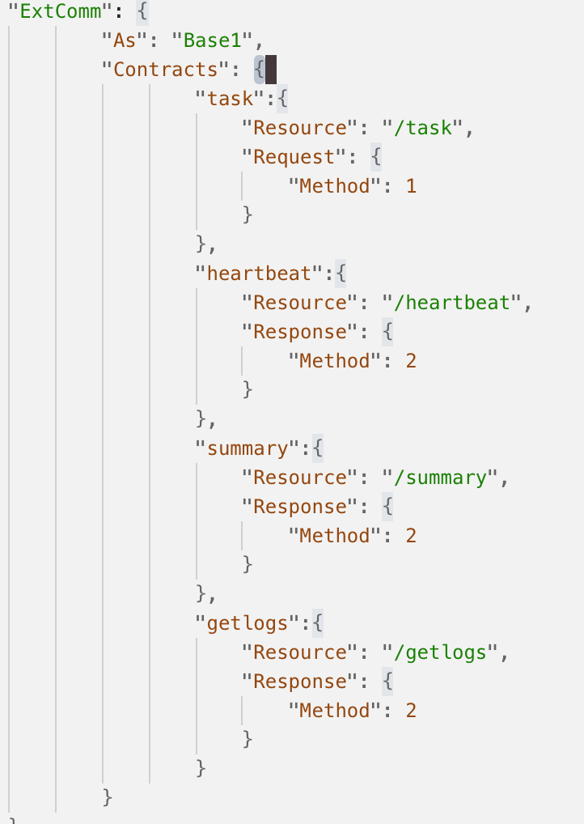
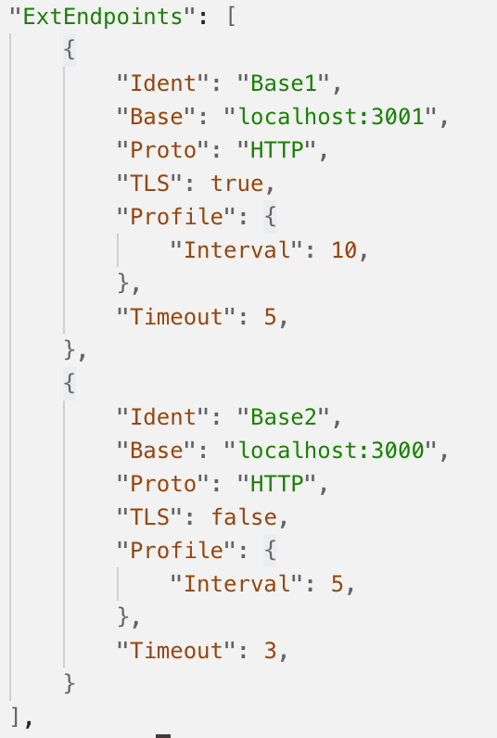
Construction: Tactical Features

Slide 13
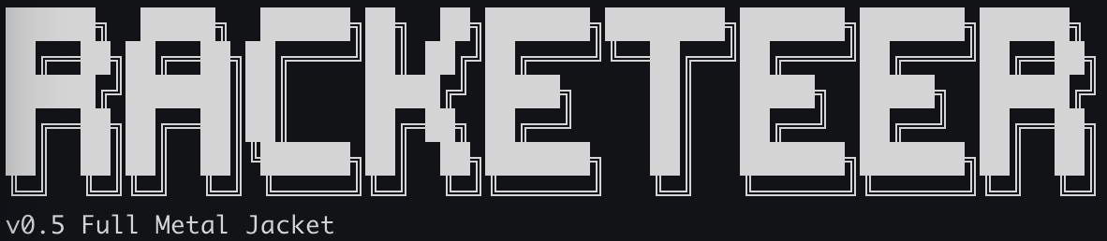

Racketeer Toolkit Demo

Slide 14
Offensive Summary
Simulate controlled ransomware lifecycle
Deliver last mile monetization module for teams
Facilitate existence of response process, align with it and refine it.
Verify offensive and defensive triage deficiencies in approaches

Slide 15
Notes to Defenders
Don’t signature the tool, pay attention to behaviors
Artifacts may be minimal
IOCs tied to implementation. Test agent is weakened on purpose
Instrument environments
correlate operational, performance, security messages

Slide 16

EOF
Thank you!
https://github.com/dsnezhkov/racketeer

